Slide 1
Shors Algorithm Basics and Implementation in Qiskit
Made By: Neil Gupte (10445674)
Aditya Kulkarni(10455633)

Slide 2
1.
Cryptography

Slide 3
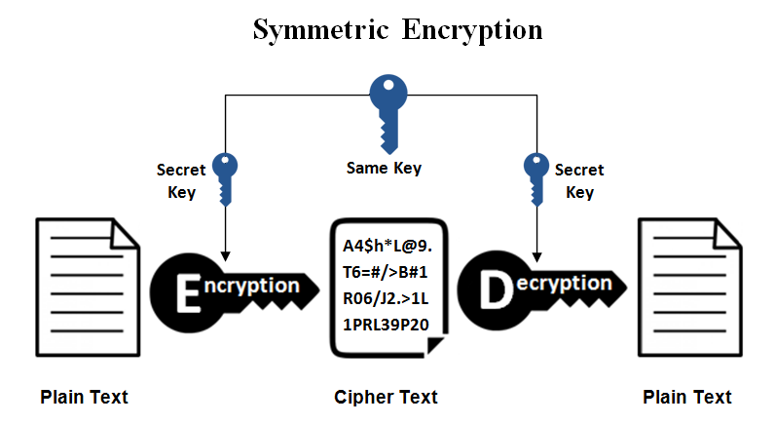
Types of Cryptography
Symmetric Key Cryptography

Slide 4
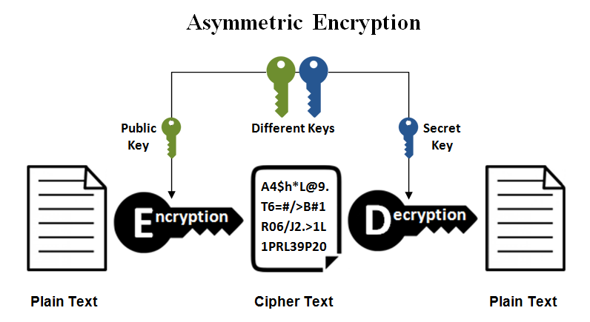
Types of Cryptography
Asymmetric Key Cryptography

Slide 5
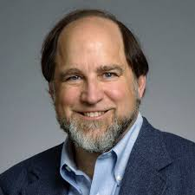
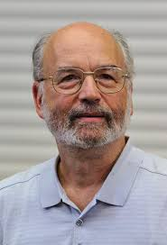
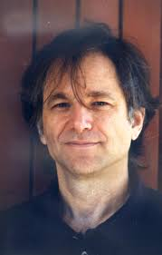
Guess Who?

Slide 6
Guess Who?
Ron Rivest
Adi Shamir
Leonard Adleman

Slide 7
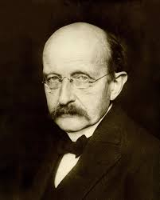
Science advances one funeral at a time.
Max Planck

Slide 8
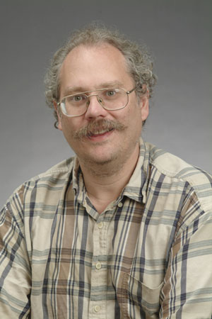
Guess Who?

Slide 9
Guess Who?
Peter Shor

Slide 10
2.
Shors Algorithm

Slide 11
Steps for Shors Algorithm
Pick a random number a < N
Use Euclidean Algorithm to find GCD of a and N.
If this is not 1, you are done.
Find the period r of a function a^x mod N.
If r is odd OR a ^ r/2=-1 mod N go back to step 1.
gcd(a^{r/2} + 1,N) and gcd(a^{r/2} - 1,N) are both nontrivial factors of N. We are done.
Where is the magic in all of this ?

Slide 12
Step 4 is where the real magic happens
Pick a random number a < N
Use Euclidean Algorithm to find GCD of a and N.
If this is not 1, you are done.
Find the period r of a function a^x mod N.
If r is odd OR a ^ r/2=-1 mod N go back to step 1.
gcd(a^{r/2} + 1,N) and gcd(a^{r/2} - 1,N) are both nontrivial factors of N. We are done.
Finding the period of a function a^x mod N is exponential complexity using a classical computer but the quantum period finding routine has polynomial complexity

Slide 13
An example of Shors to factorise 15
Randomly chose a number less than 15: a=4
GCD(4,15)=1
Period of 4^x mod 15 =2.
r is even so we are good
4^{^2/2} – 1=3 GCD(3,15)=3 and 4^{^2/2 +} 1=5 GCD(5,15) =5
15=3*5

Slide 14
An example of Shors to factorise 1517
Randomly chose a number less than 1517: a=10
GCD(10,1517)=1
Period of 10^x mod 1517 =15 this is an odd number so go to step 1.
Randomly chose a number less than 1517: a=14
GCD(14,1517)=1
Period of 14^x mod 1517 =24 this is an even number so go ahead.
14^{^24/2} – 1=56693912375295, GCD(56693912375295,1517)=37
14^{^24/2} +1=56693912375297, GCD(56693912375297,1517)=41
1517=37 * 41
4^{^2/2} – 1=3 GCD(3,15)=3 and 4^{^2/2 +} 1=5 GCD(5,15) =5
15=3*5

Slide 15
3.
Quantum Fourier Transform

Slide 16
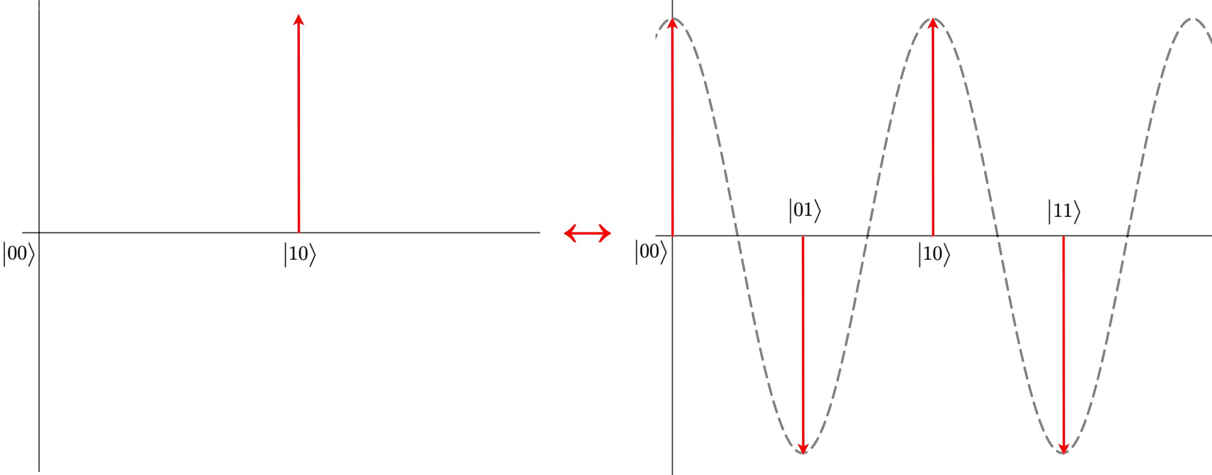
Quantum Fourier Transform
• FT allows us to extract the underlying periodic behaviour of a function

Slide 17
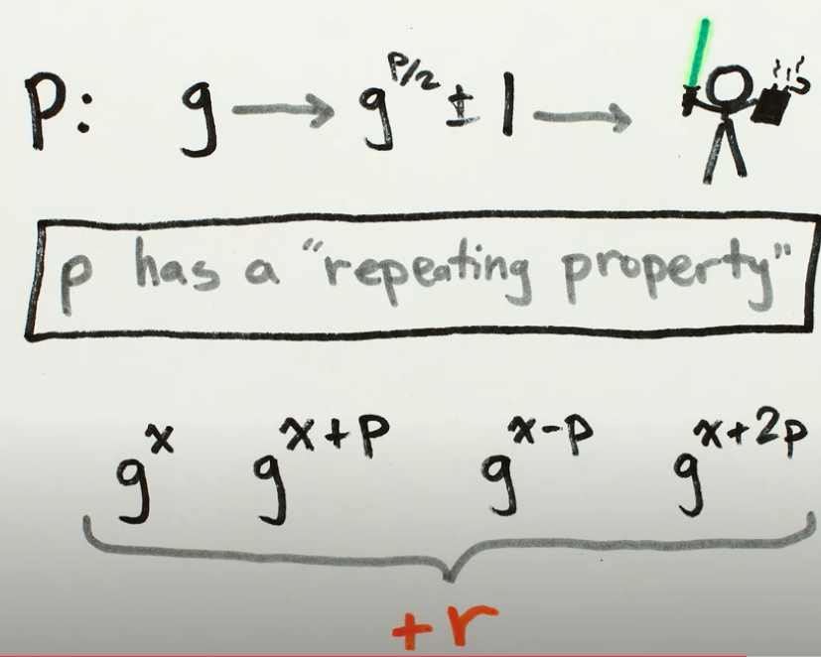
Quantum Fourier Transform

Slide 18
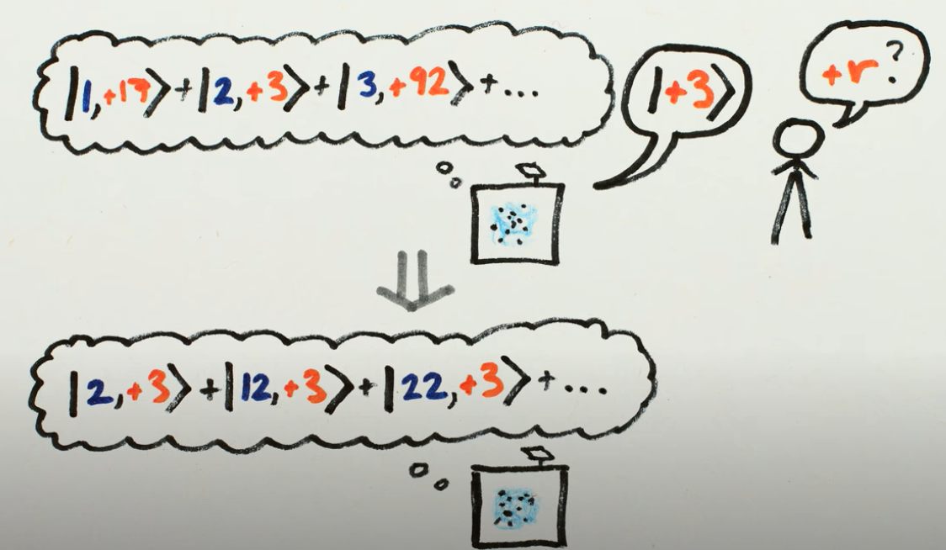
Quantum Fourier Transform

Slide 19
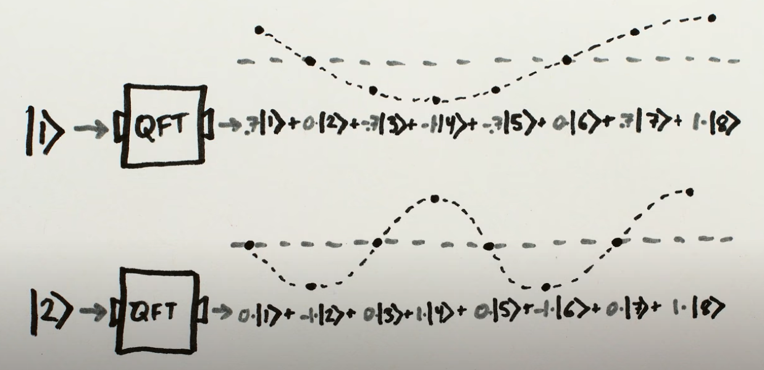
Quantum Fourier Transform

Slide 20
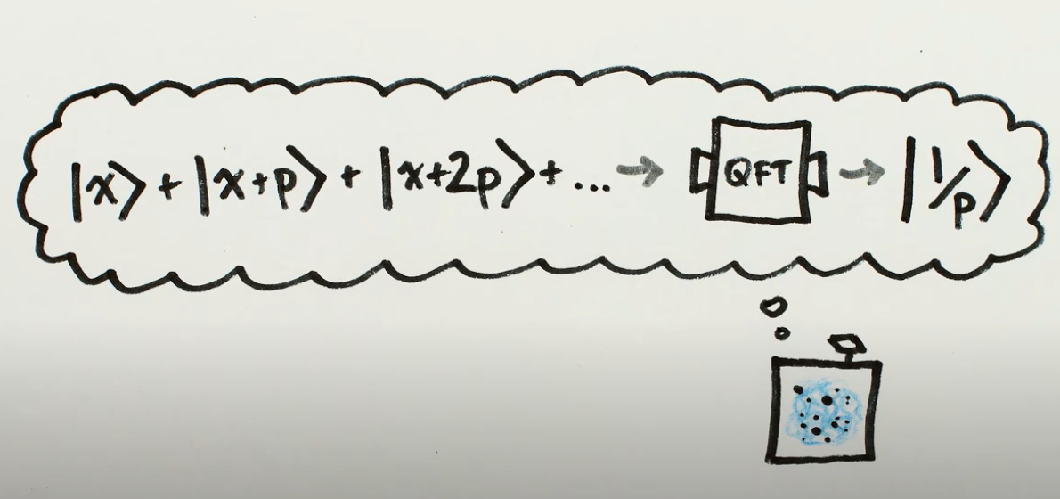
Quantum Fourier Transform

Slide 21
Is RSA dead?
Implementing Shor’s Algorithm requires at least twice the number of qubits as the size of the key.
Factorising a 2048 bit key is estimated to require a quantum computer with around 6000 quibts
The biggest gate logic quantum computer has 72 qubits.
We should move towards post quantum cryptographic algorithms like BB84.

Slide 22
Thank You

